Slide 1



UNIVERSITY INSTITUTE OF ENGINEERING
COMPUTER SCIENCE ENGINEERING
Bachelor of Engineering
Cloud Computing(CST-411)
Prepared By: Ms. Himanshu(E11818)
Topic : Google Cloud Platform
DISCOVER . LEARN . EMPOWER

Slide 2
Overview
why use Google Cloud Platform
Benefits of Google Cloud Platform,
Key features of Google Cloud Platform,
Google Cloud Platform Services,
Creating a Free Tier Account
and VM Instance on Google Cloud Platform, etc.

Slide 3
Cloud computing
It is defined as the services offered through remote servers on the internet.
These services might include database storage, applications, compute power and other IT resources over the pay-as-you-go pricing approach.
The remote server allows users to save, modify, or process data on the internet or cloud-based platform instead of storing it on a local server or their devices.

Slide 4
Cloud computing is evolving due to fast performance, better manageability, and less maintenance.
It helps organizations to minimize the number of resources and overall infrastructure costs.
Typically, the cloud-computing providers offer their services according to the following three standard models:
Platform as a Service (PaaS)
Software as a Service (SaaS)
Infrastructure as a Service (IaaS)

Slide 5
What is Google Cloud Platform?
Google Cloud Platform (GCP) is a suite of cloud computing services provided by Google.
It is a public cloud computing platform consisting of a variety of services like compute, storage, networking, application development, Big Data, and more.
The services of GCP can be accessed by software developers, cloud administrators and IT professionals over the Internet or through a dedicated network connection.

Slide 6

Why Google Cloud Platform?
Google Cloud Platform is known as one of the leading cloud providers in the IT field.
The services and features can be easily accessed and used by the software developers and users with little technical knowledge.
Apart from this, GCP was announced as the leading cloud platform in the Gartner's IaaS Magic Quadrant in 2018. Gartner is one of the leading research and advisory company.

Slide 7
Gartner organized a campaign where Google Cloud Platform was compared with other cloud providers, and GCP was selected as one of the top three providers in the market.
Most companies use data centers because of the availability of cost forecasting, hardware certainty, and advanced control.
However, they lack the necessary features to run and maintain resources in the data center.

Slide 8
Capacity
Security
Network Infrastructure
Support
Bandwidth
Facilities

Slide 9
Benefits of Google Cloud Platform
Some of the main benefits of Google Cloud Platform are explained below:
Best Pricing: Google enables users to get Google Cloud hosting at the cheapest rates.
The hosting plans are not only cheaper than other hosting platforms but also offer better features than others.
Work from Anywhere: Once the account is configured on GCP, it can be accessed from anywhere.
That means that the user can use GCP across different devices from different places.
It is possible because Google provides web-based applications that allow users to have complete access to GCP.

Slide 10
Private Network: Google has its own network that enables users to have more control over GCP functions.
Due to this, users achieve smooth performance and increased efficiency over the network.
Scalable: Users are getting a more scalable platform over the private network.
Google is always working to scale its network because there can be any amount of traffic at any time.

Slide 11
Security: There is a high number of security professionals working at Google. They always keep trying to secure the network and protect the data stored on servers.
Redundant Backup: Google always keeps backup of user's data with built-in redundant backup integration. In case a user has lost the stored data, it's not a big problem.

Slide 12
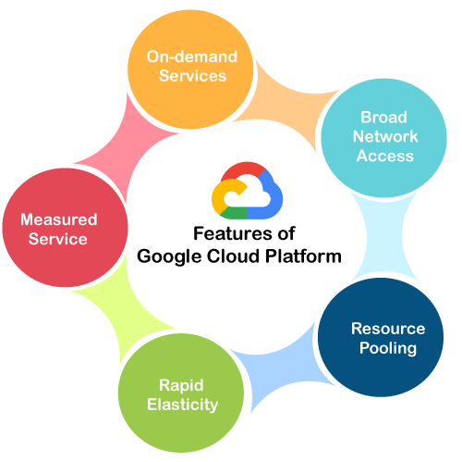

Slide 13
Key Features of Google Cloud Platform
On-demand services: Automated environment with web-based tools. Therefore, no human intervention is required to access the resources.
Broad network access: The resources and the information can be accessed from anywhere.
Resource pooling: On-demand availability of a shared pool of computing resources to the users.
Rapid elasticity: The availability of more resources whenever required.
Measured service: Easy-to-pay feature enables users to pay only for consumed services.

Slide 14
Working of Google Cloud Platform
When a file is uploaded on the Google cloud, the unique metadata is inserted into a file. It helps identify the different files and track the changes made across all the copies of any particular file.
Suppose that MS Office is implemented on Cloud to enable several people to work together.
The primary aim of using cloud technology is to work on the same project at the same time.
We can create and save a file on the cloud once we install a plugin for the MS Office suite.

Slide 15
This will allow several people to edit a document at the same time. The owner can assign access to specific people to allow them to download and start editing the document in MS Office.
Once users are assigned as an editor, they can use and edit the document's cloud copy as desired.
The combined, edited copy is generated that is known as the master document. GCP helps to assign a unique URL to each specific copy of the existing document given to different users.
However, any of the authorized users' changes will be visible on all the copies of documents shared over the cloud.
In case multiple changes are made to the same document, then GCP allows the owner to select the appropriate changes to keep.

Slide 16
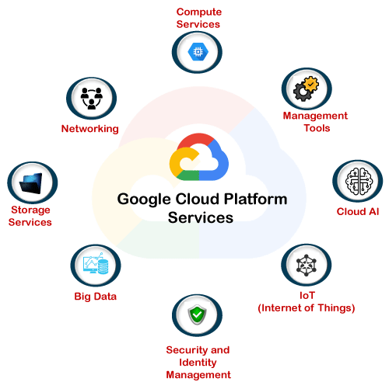
Google Cloud Platform Services

Slide 17
Google Cloud Platform Services
Google provides a considerable number of services with several unique features. That is the reason why Google Cloud Platform is continually expanding across the globe. Some of the significant services of GCP are:
Compute Services
Networking
Storage Services
Big Data
Security and Identity Management
Management Tools
Cloud AI
IoT (Internet of Things)

Slide 18
THANK YOU

